Slide 1
Young People Survey
Machine Learning Case Study
By Omar Askar

Slide 2
Overview
Background and Dataset Description
Problem Statement
Exploratory Data Analysis
Features and Targets
Hypothesis Testing
Models
Logistic Regression
Random Forest
Extra Random Trees
Conclusion, Recommendations & Moving Forward

Slide 3
Background and Dataset Description
A Kaggle case study a survey for people aged between 15 – 30 years
The data file consists of 1010 rows and 150 columns (139 integer and 11 categorical). All variables were used in this case study
The variables can be split into the following groups:
Music preferences (19 items)
Movie preferences (12 items)
Hobbies & interests (32 items)
Phobias (10 items)
Health habits (3 items)
Personality traits, views on life, & opinions (57 items)
Spending habits (7 items)
Demographics (10 items)

Slide 4
Problem Statement
The right question?
Can we predict the saving habits of individuals given the other variables?
Criterion | Analysis
Specific | We are measuring the difference between the null model (no correlation between saving habits and the other features)
Measurable | Through training, testing, and cross-validation, we can measure the prediction accuracy
Answerable | A classification problem
Relevant | Relevant for psychology studies
Time bound | Using three classification models, obtaining a prediction should take minutes
SMART

Slide 5
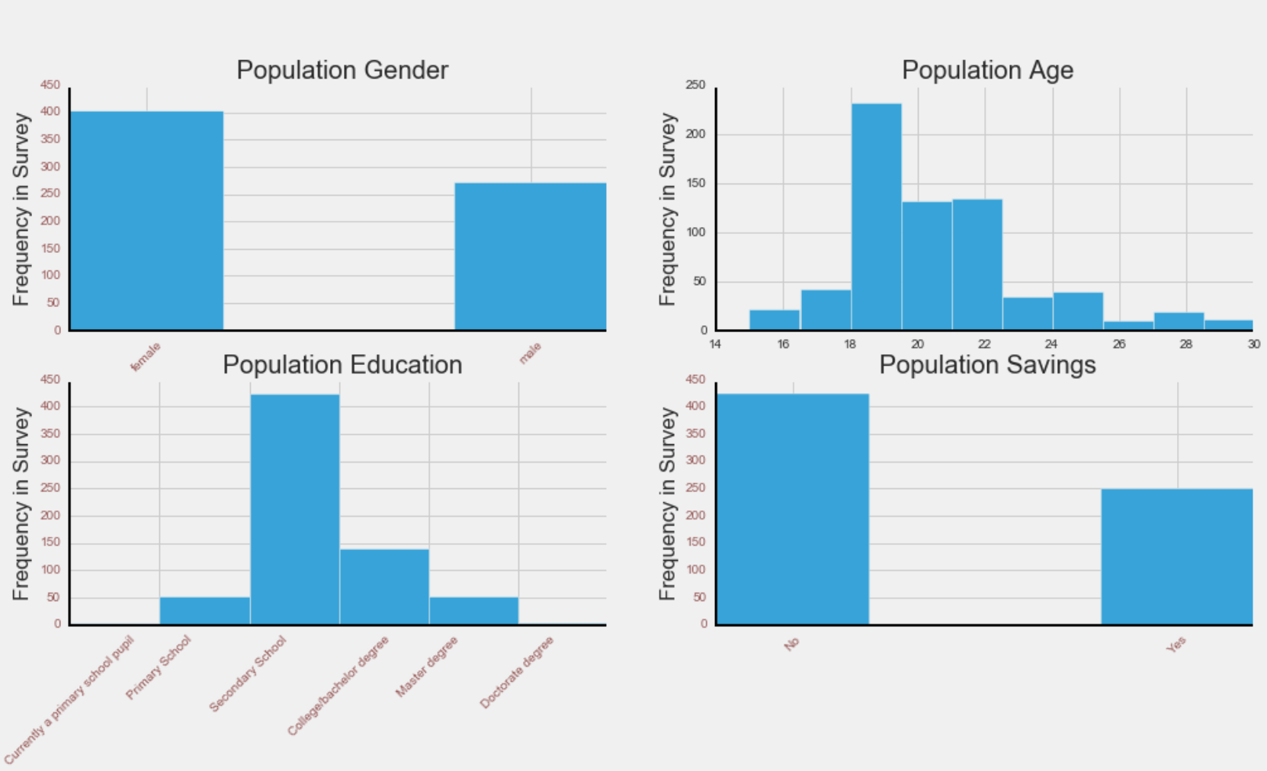
Exploratory Data Analysis
In this survey population:-
59% of the population are females
Avg population age is 20.4, avg female age: 20.14, and avg male age: 20.8
On average, more females are into Arts than males, whereas more men are into Hard Sciences and Computer Sciences

Slide 6
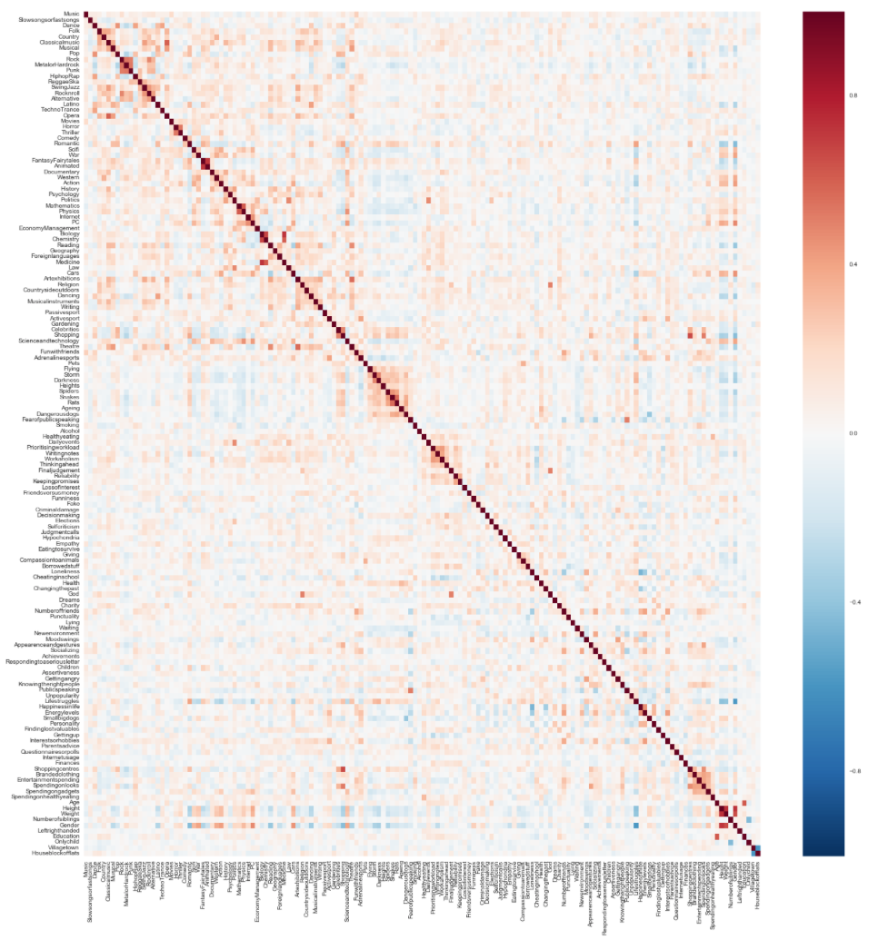
Exploratory Data Analysis
On average, female save more than males, whereas males are noticeably more interested in sports than females
Interest in music and movies is roughly equally distributed between males and females
On average, women in the survey tend to do slightly better on saving money than men
Correlation Plot

Slide 7
Features and Targets
Features: 149 columns (all but ”Finances” )
Target: “Finances” column, which indicates the individual’s tendency to save money on a scale of 1 to 5 (i.e. 1 doesn’t save, 5 saves the most)
In order for this problem to be a binary classification problem, the target variable was converted into a binary class target where:
Classes 0,1,2 were replaced with 0
Classes 4,5 were replaced with 1

Slide 8
Hypothesis Testing
Is there any gender differences in money saving?
no enough evidence to show that females and males have different money savings habits
Is there any differences in money saving between people from cities or villages?
evidence suggests that people from villages are more financially conservative than people from cities
Is there any differences in money saving between education level?
no enough evidence to show that people with different education level have different money saving habits
Notes:
CODE

Slide 9
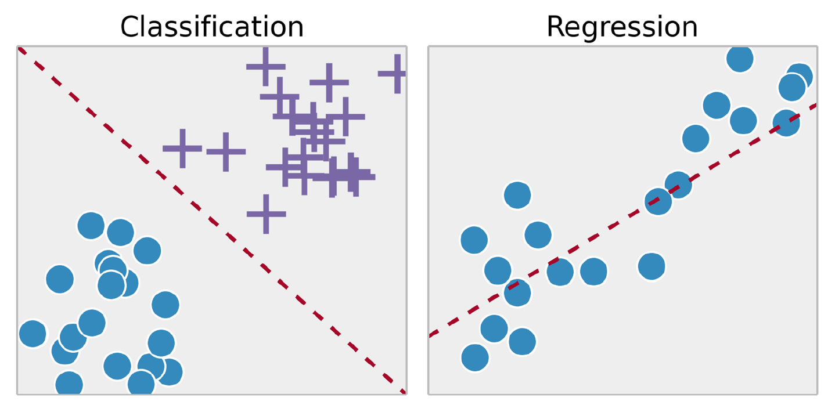
Models – Logistic Regression
Goal To predict the target’s class -Individual saves or doesn’t save money- based on the associated features
Theory
Why?
How? Probability of an outcome of an observation falls into one of two categories – or more ?)
Threshold is 0.5 (no class is more important than the other)

Slide 10
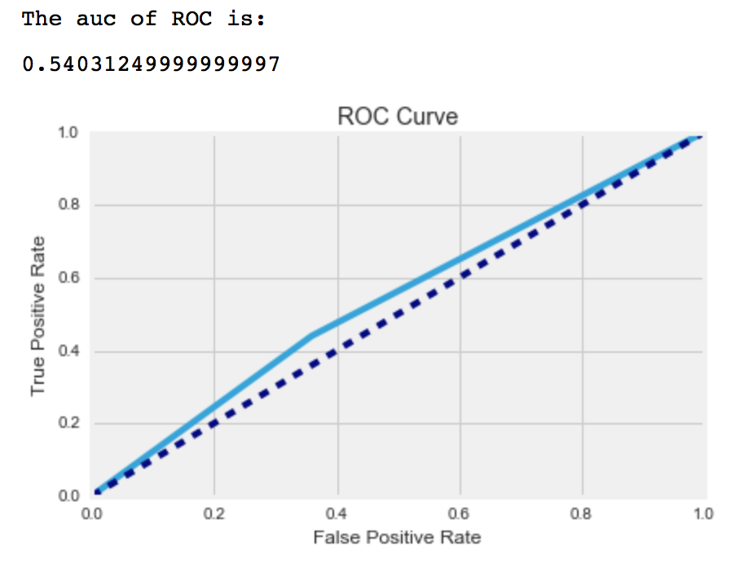
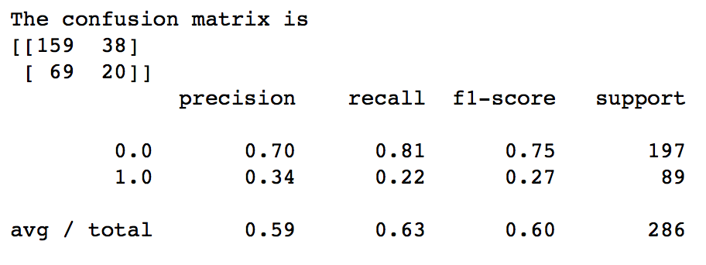
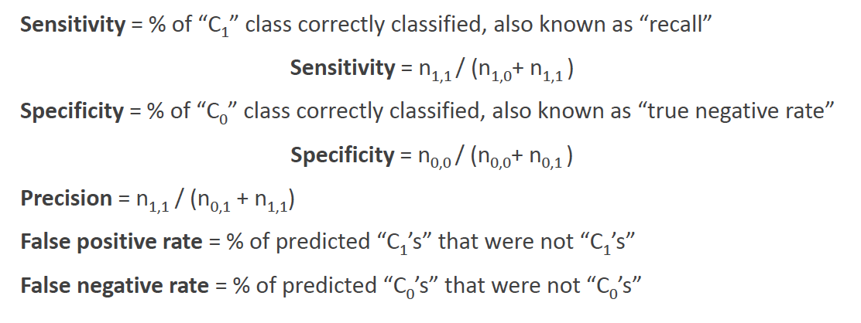
Models: 1. Logistic Regression
Model Performance
70& training data, 30% testing data
Area Under Curve (ROC): 54%
Model Accuracy (Cross Validation): 62.0%
The model doesn’t perform well as the number of features is large

Slide 11
Models: 2. Random Forest
Goal: To predict the target’s class - Individual saves or doesn’t save money- based on the associated features
Idea: Combine a number of decision trees with bad/moderate accuracy into a big forest with a higher accuracy using bagging (Bootstrap sampling and aggregation) and random feature sampling

Slide 12
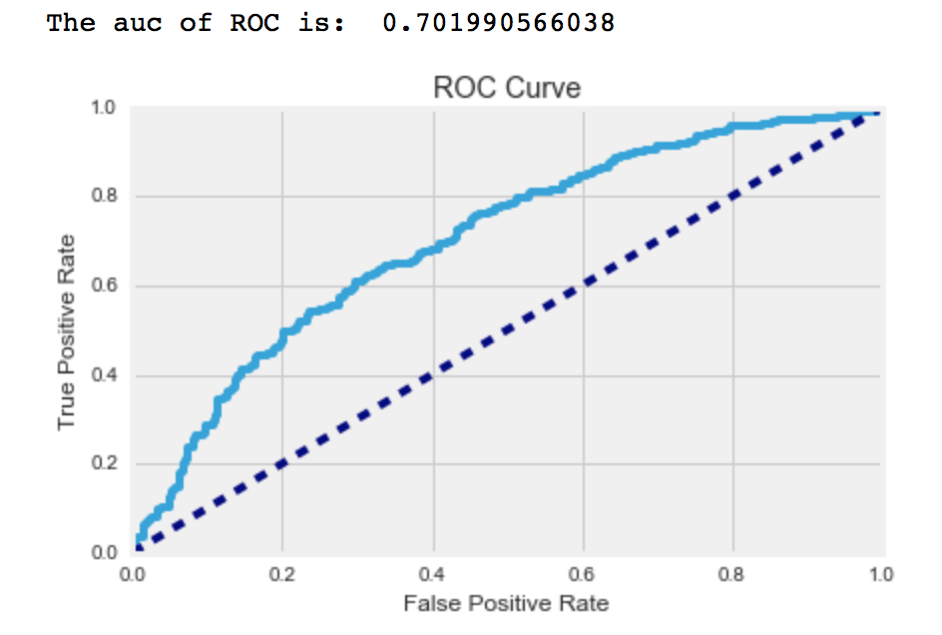
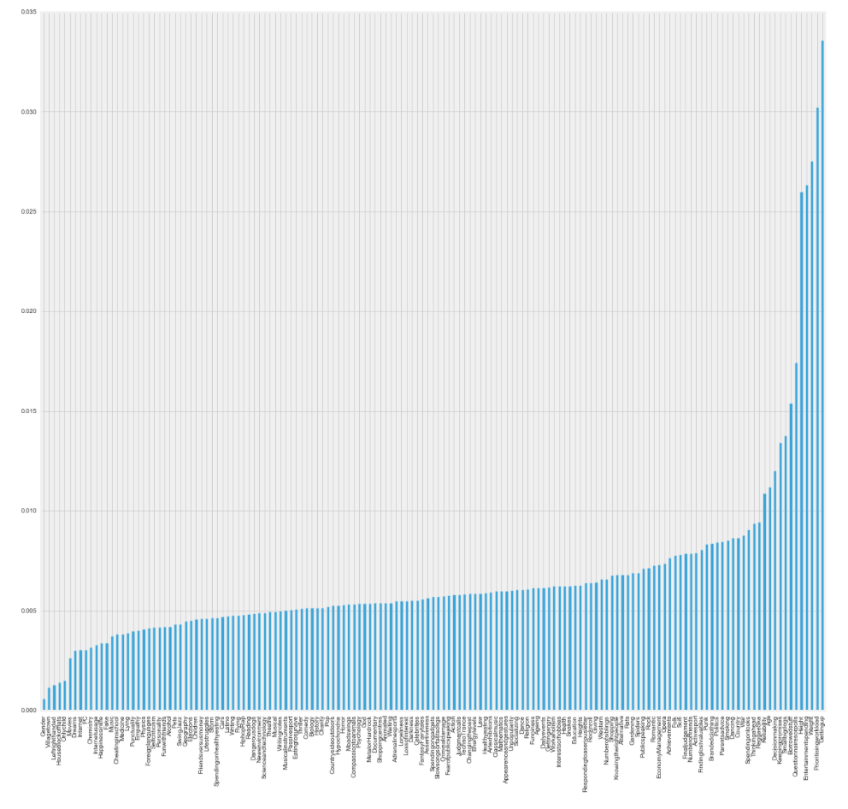
Models: 2. Random Forest
Model Performance
The AUC in the initial run is 0.7
Feature importance
The plot shows the importance of each variable in the output accuracy
Example: Height, Weight, Active in Sports are surprisingly more influential than Economy Management

Slide 13
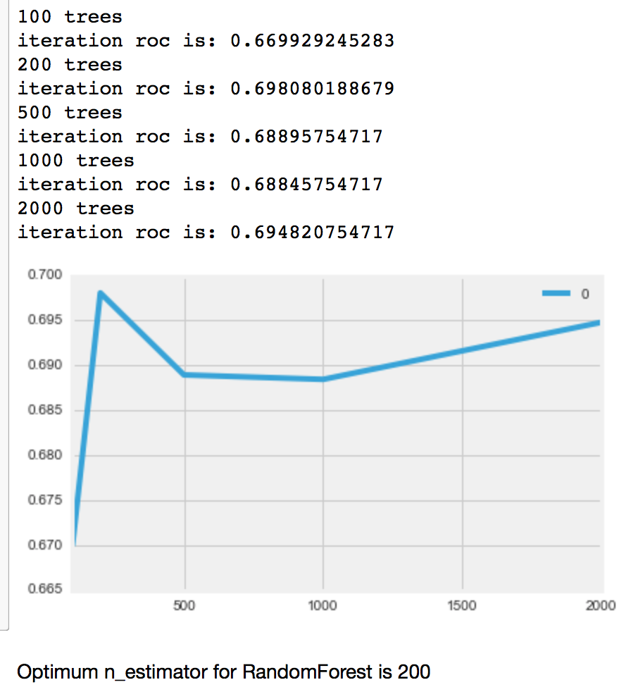
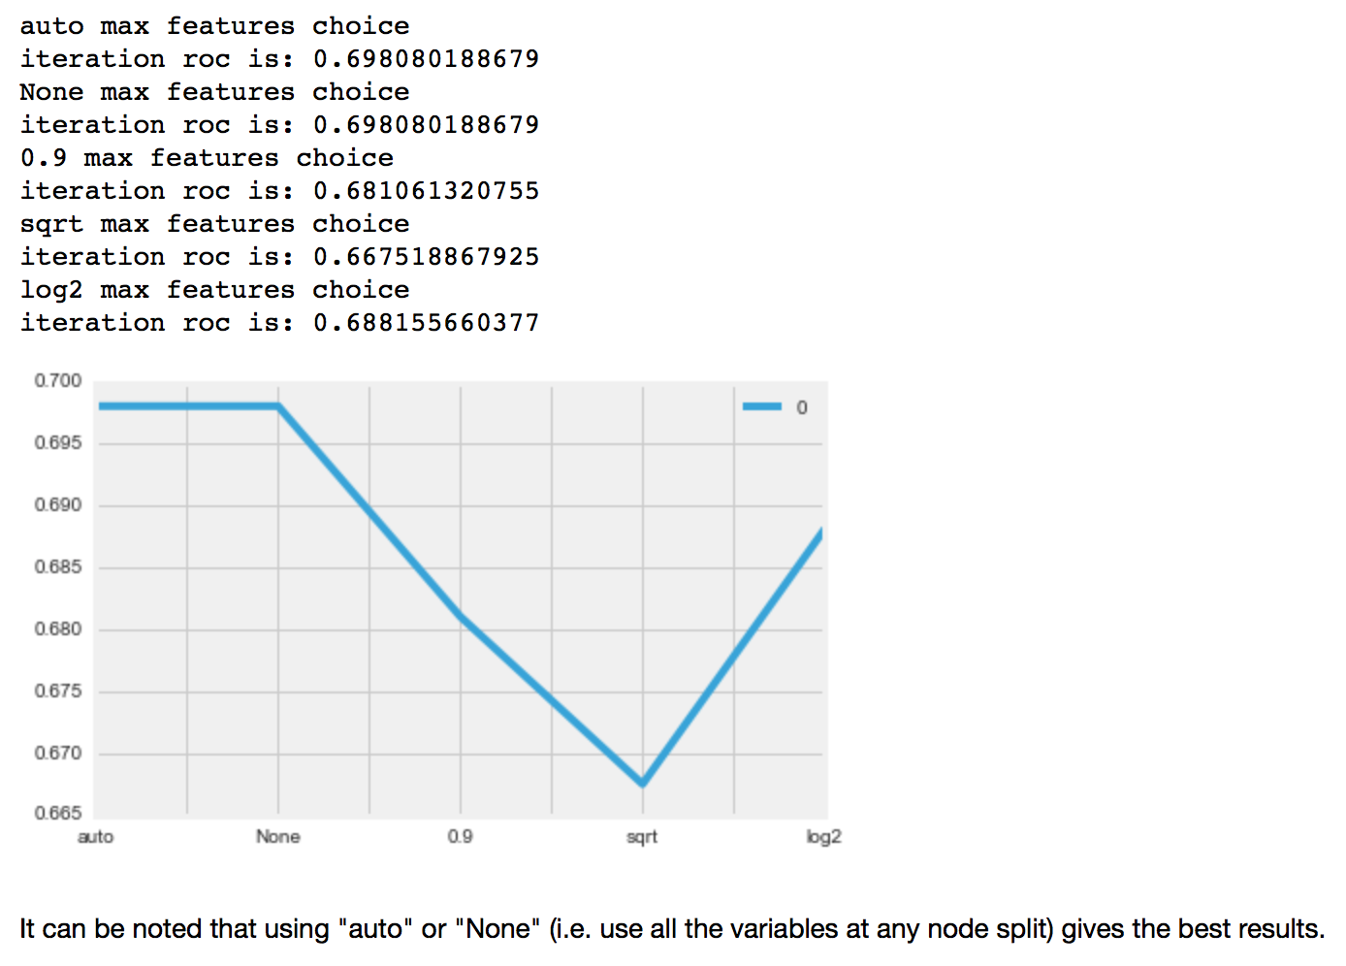
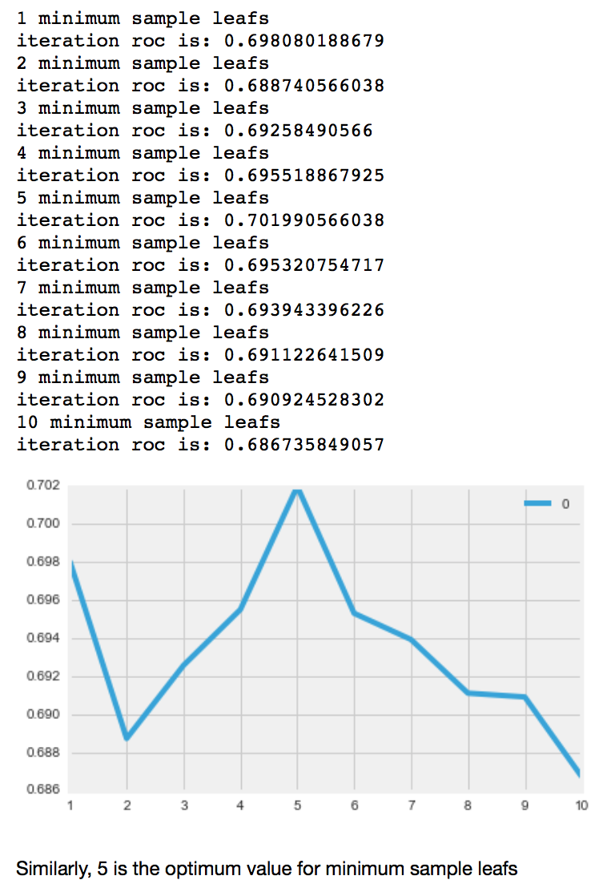
Models: 2. Random Forest
Model Optimization
model = RandomForestRegressor(n_estimators=?, oob_score=True, n_jobs=-1, random_state=102, max_features=?, min_samples_leaf=?)

Slide 14
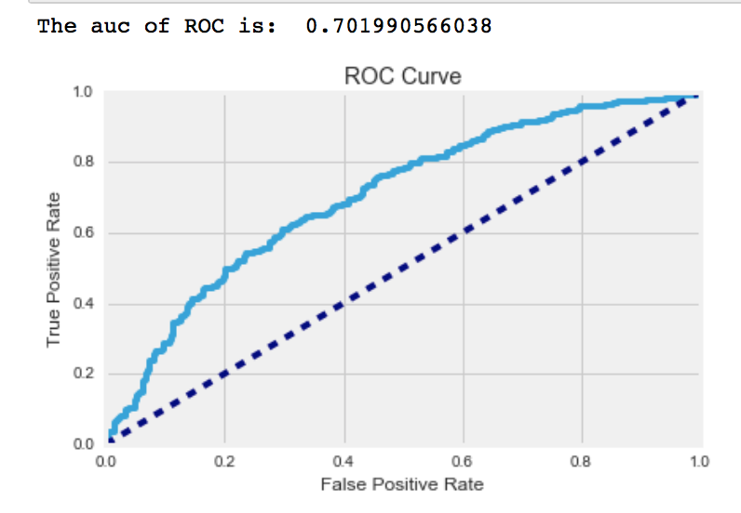
Models: 2. Random Forest
Rerun with the optimizing parameters
Area Under Curve (ROC curve): 0.7

Slide 15
Models: 3. Extra Random Trees
Goal: To predict the target’s class -Individual saves or doesn’t save money- based on the associated features
Idea:
Combine a number of decision trees with bad/moderate accuracy into one big forest with a higher accuracy using Bagging.
The difference between ERT and Random Forest is that at any given node, Random Forest optimizes the split, while ERT splits at random

Slide 16

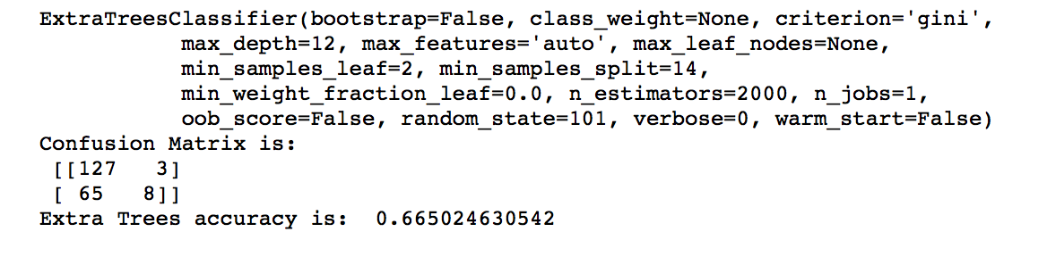
Models: 3. Extra Random Trees
Model Optimization
rsearch = RandomizedSearchCV(clf, param_distributions=param_dist, n_iter=25)

Slide 17
Models: 3. Extra Random Trees
Initial Extra Random Trees Cross Validation accuracy is: 0.66
After optimizing (sampling and combining results), that accuracy increased to 0.83, which is not bad

Slide 18
Conclusion
Extra Random Trees gave the best results
Logistic Regression model doesn’t perform well in this case study as a result of having a large feature numbers
While Random Forest and Extra Random Trees are very similar classification algorithms that follow the same concept, Extra Random Trees was more robust and gave better accuracy
Optimizing the used parameters for Random Forest and Extra Random Trees boosts the performance and significantly increases accuracy

